Slide 1
Entering Grade 10 Course Selection 2019-2020
Grade 9
Homeroom Teacher Presentation

Slide 2
Grade 9 Courses Must be Passed
All Grade 9 courses must be passed in order to enter corresponding Grade 10 courses
Failed courses must be repeated in Summer School (preferred, if available) or in Grade 10
Courses repeated in Grade 10 will result in the corresponding Grade 10 course to be taken in Grade 11
This will impact the number of credits you can earn toward graduation in grades 11-12

Slide 3
Course Failures Impacts on Graduating on Time
Students are enrolled in five courses per semester for four years.
In grade 11, courses will begin to be valued with course credits.
In the two years of grades 11 and 12, students can earn up to 20 credits (5 courses per semester). 17 must be passed.
If you are taking grade nine courses in grade ten or grade 10 courses in grade 11, it means they are holding the place in your schedule of a grade 11 or 12 course later on.
Without doing summer school, you can only fail 3 one semester courses in your four years and still graduate on time. Courses like English (full year-are worth two single semester courses). For example, if you failed English and two more courses in grade 9, you are off track to graduate on time, unless you go to summer school.

Slide 4
Grade 10 Compulsory Program
English 10 (full year)
Geometry, Measurement & Finance or FI GMF 10
Numbers, Relations & Functions or FI NRF 10
Post Intensive French/Maliseet 10 or
*FI Language Arts 10 (If you were in Immersion, you are required to continue in FILA 10)
Science or FI Science 10
Social Studies or FI Social Studies 10
Personal Development & Career Planning 10
THESE REQUIRED COURSES WILL BE SELECTED FOR YOU. IF YOU ARE PLANNING TO WITHDRAW FROM IMMERSION, SEE GUIDANCE.
And two additional electives

Slide 5
Grade 10 Electives Choose Just Two
Broad Based Technology 10
Introduction to Applied Technology 110-1 credit
Music 10* Only one of the following:
Choral, Instrumental, Keyboard or Guitar
Visual Arts 10
Health & Physical Education 10
*These are Prerequisites for Grade 11/12 courses

Slide 6
The Course Descriptions of Each of the Grade 10 Electives Follow

Slide 7
Broad Based Technology 10
Designed to provide students with the opportunity to explore technology in a multi-activity learning environment. Students will work cooperatively in pairs. Each student will complete between seven and eight units of study (9-10 hours each in length) in a technology-related area, using software such as: i-Movie, Photoshop Elements, Illustrator, Tabletop, AutoCAD LT, Authorware, Even More Contraptions, Dreamweaver, Flash and Excel.

Slide 8
BBT 10 Continued
Other technology-related areas include Engineering, Electrical, and Digital Graphics. Students will think critically and act logically to evaluate situations, solve problems, and make decisions relative to the area that is being studied.

Slide 9
Introduction to Applied Technology 110
Applied Technology is a hands-on course that develops skills in the areas of basic cabinet making, plumbing, crack filling, electrical and mechanical work, and the proper use of hand and power tools. This course will enable students to gain experience and confidence in practical areas they can use for the rest of their lives.
Lab fee: $50
Note: There are limited number of seats for
Grade 10 students. You may select this for an elective. Do not select this for an alternate-high demand course.

Slide 10
Music 10 May Choose Only One Music Option
Offers students an opportunity to develop technical and performance skills in:
Choral (voice)
Instrumental (wind or percussion)
Keyboard
Guitar
Each is a Prerequisite for Music 112
Choral; Guitar; Instrumental; Keyboarding
If you choose a music option, make sure you select the proper course and code when inputting it into the computer. It is easy to make an error and have your schedule wrong as result.

Slide 11
Visual Arts 10
Designed to cover a variety of media, both 3-D and 2-D as well as art history and theory experienced through art projects. Students will explore each of the following types of media:
Sculpture 3-D (clay, papier maché)
Drawing 2-D design (perspective, tone/shading, drawing from observation)
Painting 2-D design (water colour, colour theory, landscapes, ½ portraits, still life)
Prerequisite for Graphic Arts 110 and Visual Arts 110

Slide 12
Health & Physical Education 10
Designed to introduce teenagers to lifetime fitness activities, divided into 3-week units. Emphasis is placed on effort and interest, rather than athletic ability. Depending on the semester, activities may differ.
-Weight training, anaerobic/aerobic exercise
-Badminton -Basketball -Volleyball
-Soccer -Softball -Orienteering
Prerequisite for Outdoor Pursuits 110 &
Physical Education Leadership 120

Slide 13
Choosing Electives
Choose your two electives carefully.
Consider your interests and the courses you may wish to take in Grades 11 & 12.
You must also choose one elective as an
Alternate that will be used if your
chosen electives cannot be scheduled.

Slide 14
The Course Selection Process
All courses will be selected using an on-line request process through Power School
This will be done during Extended Homerooms March 18th -21st.
You will need your user ID and password to gain access to the system; you should have logged in once to a school computer in order to change your password prior to this. Ask your HR teacher if you need to reset your password.
You will need a completed course selection form.
You will not be allowed to enter any course requests without the form

Slide 15
Once requests have been entered and submitted, they cannot be changed
You will receive a verification form listing the courses you have chosen; it must be signed by your parent/guardian and returned
If there are any changes, mark them on the form and they will be made
There will be no changes made after this point
Except for failures

Slide 16
The following slides are to be shown during the Extended Homerooms March 18-21 to guide students through the process

Slide 17
Log-on using Student ID & Password
In case of username /password unknowns: HR teachers need to request it via tech teachers.
Login here: Student Course Selection Login Page
Step 1: Choose 2 Elective Courses
Step 2: Choose 1 Alternate Elective
Caution: Music electives must be chosen using the course names listed on your course selection form
You will not be able to submit your request unless all screens are completed correctly

Slide 18
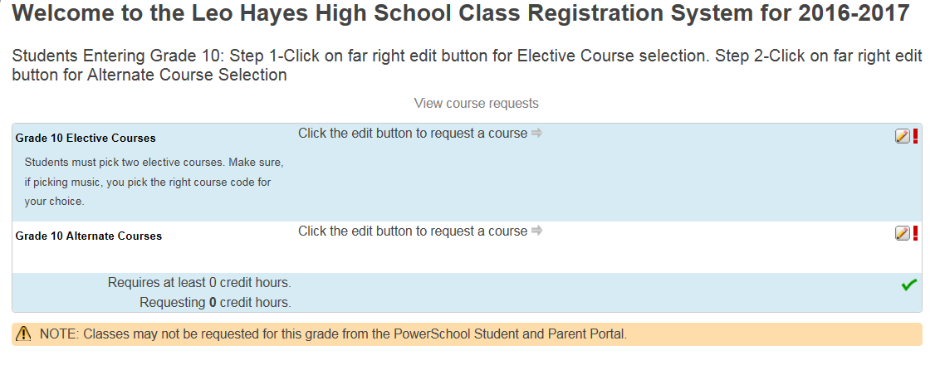
2019-2020

Slide 19
When Finished
Have your homeroom teacher verify that what you have selected matches your course planning form.
Log Off so next student can Log On
Do not shut down the computer unless directed to do so
Give your Course Planning Form to HR teacher-They will be kept on file

